Slide 1
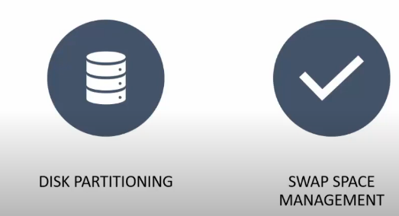

Slide 2
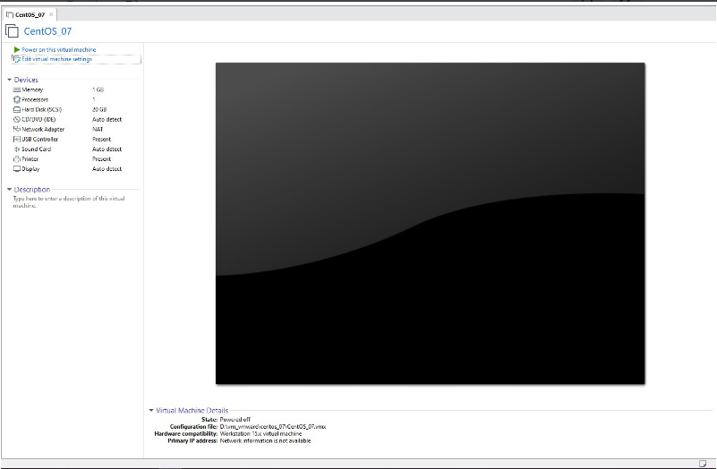
Attaching Disk:
This step points to physically connecting the disk to the system. The below screenshot specifies the system configuration.

Slide 3
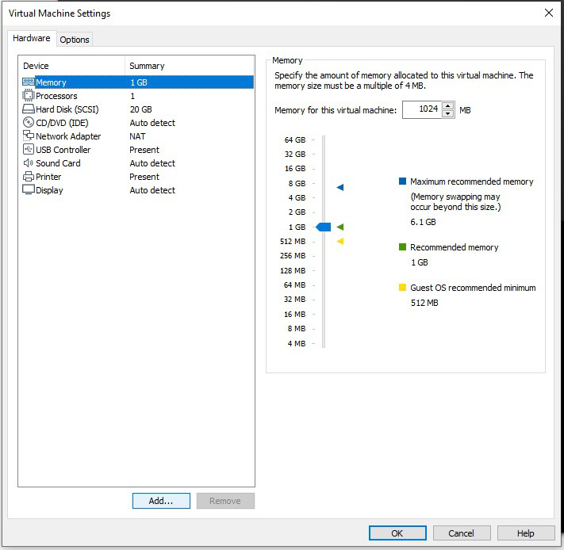

Slide 4
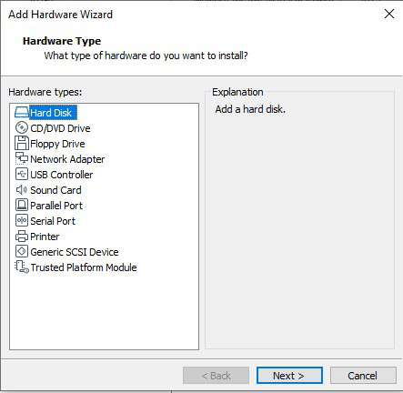

Slide 5
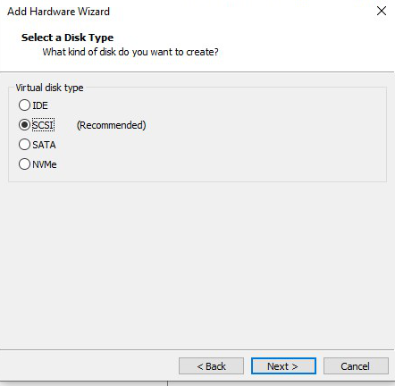

Slide 6
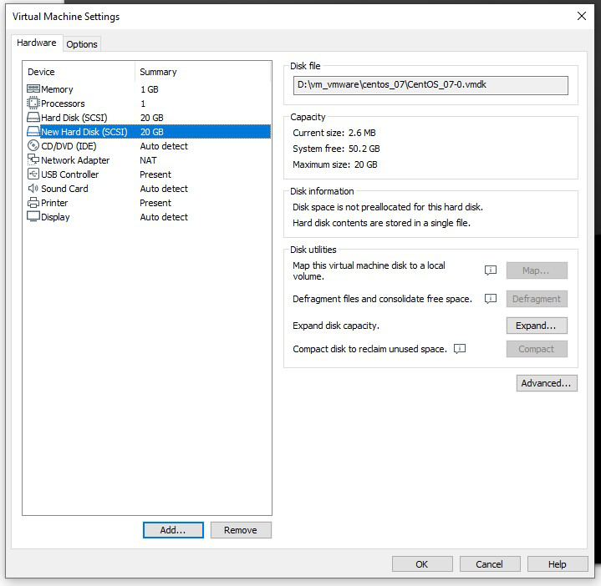

Slide 7
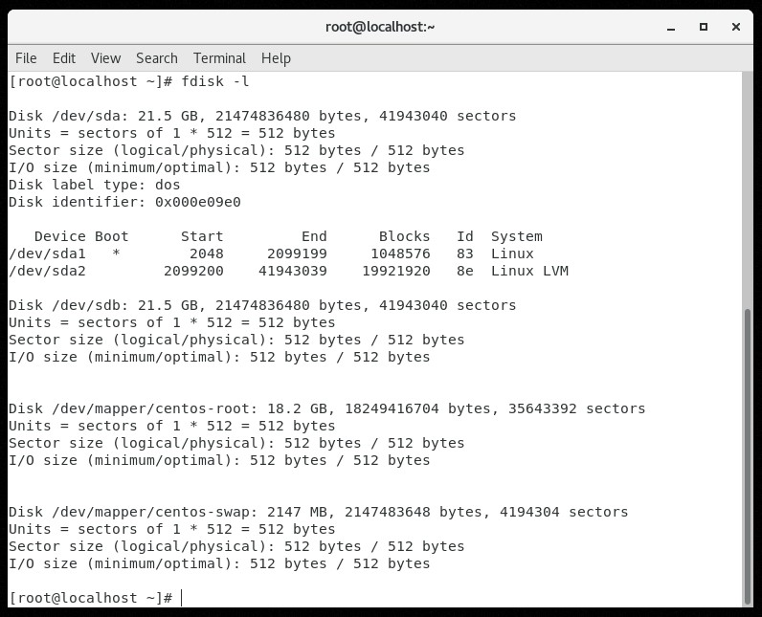
Create Partitions in the Disk
fdisk -l

Slide 8
We found that the Hard Disk that we are going to partition can be found at /dev/sdb. Use the command
fdisk /dev/sdb
It will take us to a different console where we can use the partitioning specific commands. We will be concentrating more on the following commands (or flags).
m -> help
p -> print partition table
n -> create new partition
d -> delete partition
q -> quit without writing
w -> write to disk

Slide 9
While partitioning, we should be aware of certain factors.
On a disk, we can have a maximum of four partitions
The partitions are of two types
Primary
Extended
Extended partitions can have logical partitions inside it
Among the four possible partitions, the possible combinations are
All 4 primary partitions
3 primary partitions and 1 extended partition

Slide 10
You can specify the size of the partition in two ways, either as the last cylinder number or by specifying the size directly. If we need the partition1 to be of 4 GB size (as a whole number), use
+4G

Slide 11
Create a File System on the Partition
Computers use particular kinds of file systems to store and organize data on media, like Hard Disk, CD, DVD, etc. The commonly used Linux file systems are ext2, ext3, ext4, JFS, ReiserFS, XFS, FAT (usually in Windows OS ) and B-treeFS. Inorder to specify the file system to be used in each partition, we can use the mkfs (make file system) command.

Slide 12
mkfs.vfat /dev/sdb2
This command is used to format the 2nd partition available in /dev/sdb2 to the VFAT file system. Even though we formatted the disks, it is of no use to us, unless we mount it on a directory.

Slide 13
Mounting the file systems
Let us make three directories, for mounting the first, second, and third partition using the mkdir (make directory) command.
mkdir /mount1
mkdir /mount2
mkdir /mount3
Mounting the formatted partitions can be achieved using the mount command
mount /dev/sdb1 /mount1
mount /dev/sdb2 /mount2
mount /dev/sdb3 /mount3

Slide 14
Attached a hard disk or create a virtual
fdisk –l
fdisk /dev/sdb
Press m for options
N for new partiotion
P for primary
First cylinder
Size
Assign file system and folder to partition
Mkfs.vfat /dev/sdb1
Mkdir /foldername
Mount /device /folder
Partorbe /partition (Finalize the partition)

Slide 15
Setting up Swap Space
free -m
fdisk /dev/sdb
press m for options
n for new partition
p for primary
first cylinder
size
press t for change the file system
partition id 3
l for hex code(82)
w for writing to file
partporbe /partition (finalize the partition)
mkswap /partition

